Slide 1
Conboy Proposed Cultivation and Manufacturing Facility
2727 Jacobs Ladder Rd,
Becket, MA 01223

Slide 2
MIKE AND JACK CONBOY BUSINESS PLAN OVERWIEW
Ownership
Michael “Mike” Conboy SR.
John “Jack” Conboy

Slide 3
The Goals and Objective
Mike and Jack Conboy’s goal is to obtain the community host agreement from the town of becket to own and operate a 5,000 sq. ft. cultivation Marijuana establishment here at 2727 Jacob’s Ladder Road. They plan to construct a 12,000/12,000 sq. ft. building. (2 Floors 12,000 each) Staring out as a 5,000 sq. ft. grow and over the course of 2 years open the second floor for a total of 10,000 sq. ft. grow.
After obtaining a CHA, they will secure an investor to fund the project. They plan to move carefully into the financing as to strategically place this cultivation facility in the most beneficial impact to the town of BECKET first. Mike and Jack Conboy have been approached with several great financial opportunities, but would like time to review further benefits to local financing. Once they can obtain the CHA, they feel confident there will be several more beneficial options available. Currently Mike and Jack Conboy would like to take this one step at a time.

Slide 4
The Products
Mike and Jack’s primary source of income will be with wholesale flower. As the business grows, they plan to expand to whatever is demanded in the market.

Slide 5
Target Market
Mike and Jack Conboy plan to market all Mass ME establishments throughout but not limited to MA.
Organizational timeline
Upon receiving a CHA from the Town of Becket, Mike and Jack Conboy will be able to secure financing.
Submit an application to the State
Purchase and furnish a pre-fab building
Cultivate Marijuana

Slide 6
Leadership Team
John “Jack” Conboy: 1515 Reservoir Road East Otis, MA
Born and raised in Longmeadow, Jack has dedicated the last 31 years of his life to the small community of Otis Ma. After several years traveling to Otis Reservoir in the early 60’s with his family for vacations in their small lakeside cabin, he found a love for the area. He and his family moved here in 1980 and started a logging business with his brother, friend and partner Michael “mike” Conboy. He has worked for the Town of Otis as the sanitation inspector, tree warden, constable and planning board. It’s been his privilege to serve selflessly as a part of his civic duty. Back in the day Jack was a licensed pilot, Westfield State Collage security Guard and a 32nd degree Free Masson. His goals are to achieve a stable future for himself and his family, while giving back to the community he loves so much.

Slide 7
Leadership Team (cont’d)
Michael “Mike” Conboy Sr. : “Mike” 535 Dimmock Road Otis, MA
Mike graduated college with his bachelor’s degree in business management. He was employed with IBM as management. He moved to Otis to assist his brother in the logging business. After many successful years here in the Berkshires, he longs to a difference in his local community and provide a better opportunity to his family and loved ones.

Slide 8
Contact Information:
John “Jack” Conboy
1515 Reservoir Road
East Otis, Ma 01029
# 413-530-8033
Michael “Mike” Conboy
535 Dimmock Road
Otis, Ma 01253
#413-530-6495

Slide 9
Operational Timeline
Receive provisional license July 31st 2021
Obtain liability insurance July 31st 2021
Equipment install August 3rd 2021
CCC final inspection Sept 30th 2021
Career and hiring fair October 5th 2021
Staff recruitment and hiring October 31st 2021
Final CCC license Nov.12th 2021
Staff training Nov 2nd 2021
Commence operations Dec 10th 2021
First harvest March 19th 2022
First whole sales May 10th 2022

Slide 10
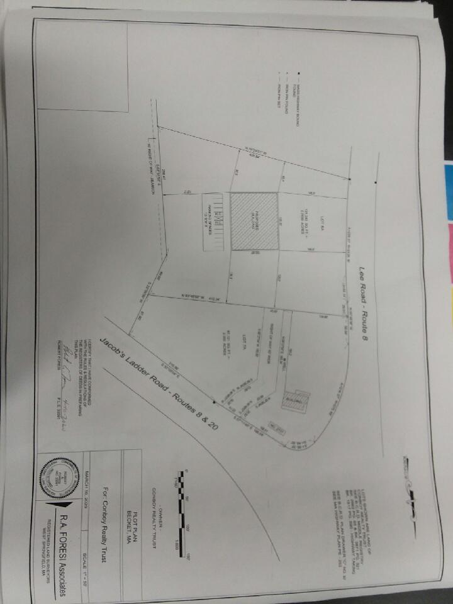
Plot Plan

Slide 11
Proposed Interior Sight Plan

Slide 12
Lighting, Shading and Odor Control
Lighting. Outdoor light levels shall not exceed 1 foot-candle along property lines, nor 10-foot candles for any location on the property. Any light poles, new or existing, will not exceed eighteen feet (18’) in overall height. All outdoor light fixtures will be shielded and aimed down to prevent light trespass onto adjacent properties.
Landscaping. This property will be landscaped to harmonize the building with surrounding uses. Landscaping shall be provided at the rate of one (1) canopy tree for every thirty feet (30’) of lineal road frontage and shall be located within fifteen feet (15’) of the front property line(s). Existing trees may count toward this requirement and may be clustered. Landscaping will consist of native, non-invasive plant species.
Control of emissions. Sufficient measures and means of preventing smoke, odors, debris, dust, fluids and other substances from this ME will be provided at all times. Technology is evolving quickly in relation to odor control, and this ME will address the best quality filters available at the time of construction of the structure.

Slide 13
Hours of Operation, Signage and Traffic Flow
Hours of operation: Monday-Sunday 9am-5pm
Signage: All signage will be posted in accordance with Ma General Law
Traffic flow: Minimum Traffic impact. 1-5 vehicles Monday-Friday for deliveries and shipments

Slide 14
Security Plan
(1) Mike and Jack Conboy shall implement sufficient security measures to deter theft of Marijuana and Marijuana Products, prevent unauthorized entrance into areas containing Marijuana and Marijuana Products and ensure the safety of Marijuana Establishment employees, Consumers and the general public by establishing true identity of all persons entering onto the property. Security measures taken by the Mike and Jack Conboy to protect the Premises, employees, Marijuana Establishment Agents, Consumers and general public shall include, but not be limited to, the following:
(a) Positively identifying individuals seeking access to the Premises of the Marijuana Establishment or to whom or Marijuana Products are being transported pursuant to935 CMR 500.105(14) to limit access solely to individuals 21 years of age or older; by requiring all persons entering the property to first show proper government issued identification.
(b) Adopting procedures to prevent loitering such as posting “no Loitering” Signs at all points of entry to the property, and ensure that only individuals engaging in activity expressly or by necessary implication permitted by 935 CMR 500.000 and its enabling statute are allowed to remain on the Premises;
(c) Disposing of Marijuana in accordance with 935 CMR 500.105(12) in excess of the quantity required for normal, efficient operation as established within 935 CMR 500.105;
(d) Securing all entrances to the Marijuana Establishment to prevent unauthorized access; by way of hires security guards 24 hours a day 7 days a week.
(e) Establishing Limited Access Areas pursuant to 935 CMR 500.110(4), which shall be accessible only to specifically authorized personnel limited to include only the minimum number of employees essential for efficient operation;
(f) Storing all Finished Marijuana Products in a secure, locked safe or vault in such a manner as to prevent diversion, theft and loss;

Slide 15
Security Plan (Continued)
(g) Keeping all safes, vaults, and any other equipment or areas used for the production, cultivation, harvesting, Processing or storage, including prior to disposal, of Marijuana or Marijuana Products securely locked and protected from entry, except for the actual time required to remove or replace Marijuana;
(h) Keeping all locks and security equipment in good working order;
(i) Prohibiting keys, if any, from being left in the locks or stored or placed in a location accessible to persons other than specifically authorized personnel; Daily key out logs will be maintained, stored and saved a locked cabinet in the office.
(j) Prohibiting accessibility of security measures, such as combination numbers, pass words or electronic or biometric security systems, to persons other than specifically authorized personnel;11/1/19935 CMR - 158
(k) Ensuring that the outside perimeter of the Marijuana Establishment is sufficiently lit to facilitate surveillance, where applicable;
(l) Ensuring that all Marijuana Products are kept out of plain sight and are not visible from a public place, outside of the Marijuana Establishment, without the use of binoculars, optical aids or aircraft;
(m) Developing emergency policies and procedures for securing all product following any instance of diversion, theft or loss of Marijuana, and conduct an assessment to determine whether additional safeguards are necessary;
(n) Developing sufficient additional safeguards as required by the Commission for Marijuana Establishments that present special security concerns;
(o) Cash handling procedures will be established, for safe cash handling and cash transportation to financial institutions to prevent theft, loss and associated risks to the safety of employees, customers and the general public; Armored Cars will be sub-contracted to handle all bank transactions.
(p) Mike and Jack Conboy will share floor plans and layout of the facility with Law Enforcement Authorities, and in a manner and scope

Slide 16
Security Plan (Continued)
as required by the municipality and identifying when the use of flammable or combustible solvents, chemicals or other materials are in use at the Establishment;
(q) Sharing the Mike and Jack Conboy’s security plan and procedures with Law Enforcement Authorities, including police and fire departments, in the Town of Becket and periodically updating Law Enforcement Authorities, police and fire departments, if the plans or procedures are modified.

Slide 17
Questions?

